Slide 1
Staying Healthy This Winter:
Preventing COVID-19 and the Flu
November 2020
Prepared by: Shelleisha Salmon-Gordon, MPH
Public Health Educator
Albany County Department of Health

Slide 2
Today's Discussion
Flu: Spread, Symptoms, Prevention
Flu vs. COVID-19
COVID-19: Spread, Symptoms, Prevention
COVID-19 Testing
Resources

Slide 3
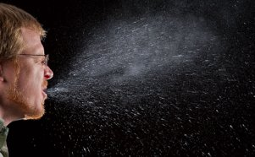
What is the Flu?
Contagious respiratory illness (influenza)
Influenza viruses affect the nose, throat, and lungs
Droplets while coughing, talking, sneezing
Mild to severe symptoms; can be fatal
Source: https://www.cdc.gov/flu/about/index.html
Notes:
Flu Complications
Older people
Young children
People with underlying health conditions
Pregnant women
3

Slide 4
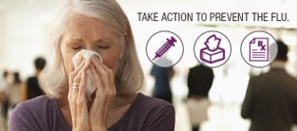
Flu Symptoms
Fever/chills
Cough
Sore throat
Runny or stuffy nose
Muscle or body aches
Headaches
Fatigue (tiredness)
Vomiting and diarrhea
Source: https://www.cdc.gov/flu/about/index.html
Notes:
*It’s important to note that not everyone with flu will have a fever.
Vomiting and diarrhea (more common in children)
4

Slide 5
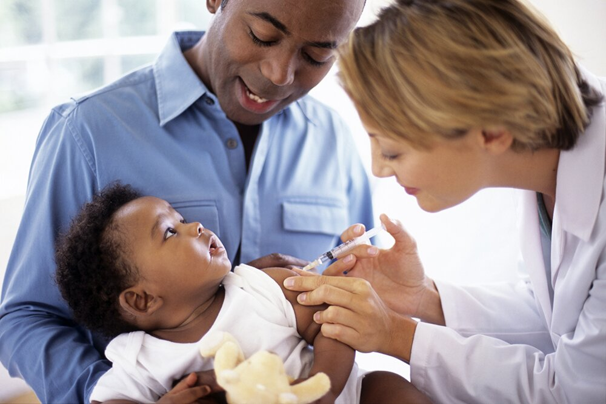
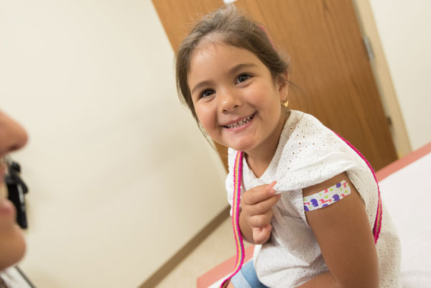
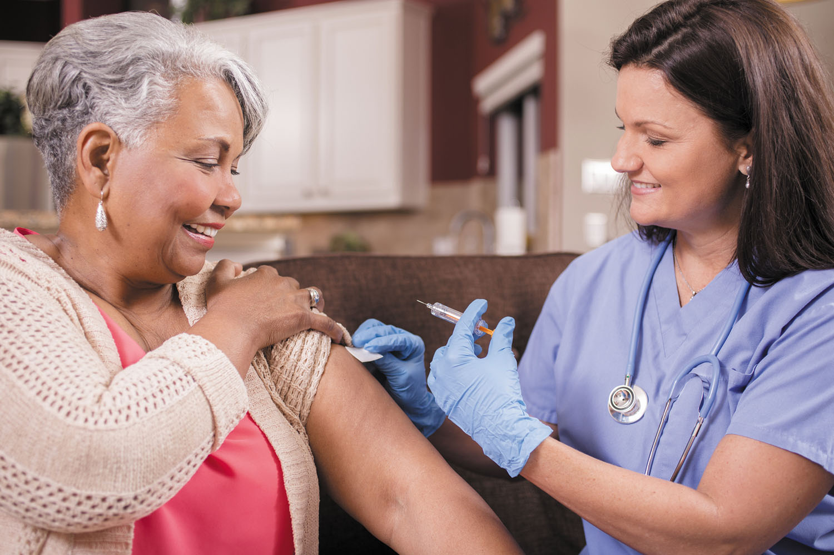
Flu Prevention
Best way – flu vaccine!
Everyone 6 months and older should get vaccinated
Older adults 65+
(Senior) high dose vaccine - 4X regular flu shot
Aging lowers immune response
Increased dose promotes stronger response
Source: https://www.cdc.gov/flu/about/index.html; https://www.cdc.gov/flu/prevent/prevention.htm; https://www.cdc.gov/flu/highrisk/65over.htm
Notes:
More important this flu season due to COVID-19
High Dose – 4 times the antigen (inactivated virus) than
Senior high dose = 4X = stronger immune response (Source: https://www.cdc.gov/flu/highrisk/65over.htm)
5

Slide 6
Flu Prevention
Everyday Practices
Avoid touching eyes, nose, mouth
Sneeze into your elbow or tissue and throw away
Wash and sanitize hands often
Antiviral medications*

Slide 7
Flu vs. COVID-19
Both contagious respiratory illnesses with similar symptoms
COVID-19:
Caused by a "novel" coronavirus
Affects multiple organs in the body
People do not always show symptoms
Source: https://www.cdc.gov/media/dpk/diseases-and-conditions/coronavirus/coronavirus-2020.html
Notes:
SARS-CoV-2 = Severe acute respiratory syndrome coronavirus 2; a new or "novel" coronavirus
Because some of the symptoms of flu and COVID-19 are similar, it may be hard to tell the difference between them based on symptoms alone, and testing may be needed to help confirm a diagnosis.
7

Slide 8
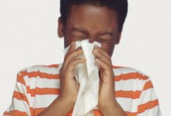
How is COVID-19 Spread?
Close contact with infected person:
6 feet or less (2 arm lengths) for more than 10-15 minutes
Touching a surface with virus and then touching
Eyes
Nose
Mouth
Respiratory droplets released through:
Coughing
Sneezing
Talking

Slide 9
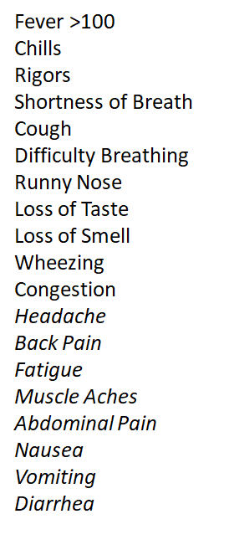
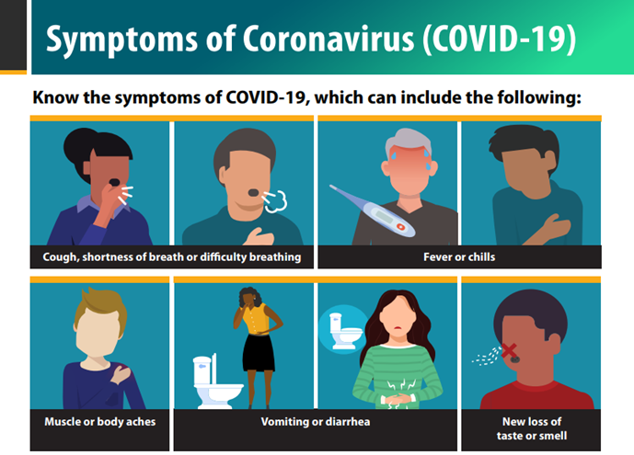
COVID-19 Symptoms
Source: Retrieved: https://www.cdc.gov/coronavirus/2019-ncov/symptoms-testing/symptoms.html

Slide 10
When to Seek Emergency Medical Care for COVID-19?
Seek emergency medical care and call 911 immediately when:
Trouble breathing
Persistent pain or pressure in the chest
New confusion
Inability to wake or stay awake
Bluish lips or face

Slide 11
Isolation vs. Quarantine
Isolation
Who Should Isolate?
Positive case (someone who receives a positive COVID-19 test result)
How Long is Isolation?
10 days since onset of COVID-19 symptoms OR 10 days since positive test result
Quarantine
Who Should Quarantine?
Someone who comes into contact (known as a "Contact") with a positive COVID-19 case
How long is Quarantine?
14 days since last contact
REMEMBER: A negative test result does not end quarantine early
Source: https://www.cdc.gov/coronavirus/2019-ncov/hcp/duration-isolation.html#:~:text=Available%20data%20indicate%20that%20persons,20%20days%20after%20symptom%20onset

Slide 12
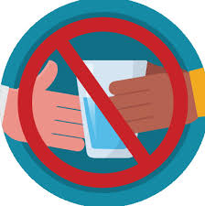
How to Effectively Isolate and Quarantine
Wear a mask!
Practice social distancing of 6ft or more.
Wash and sanitize hands often.
Stay and sleep in a private room away from others.
Check and record your temperature twice per day
Have someone else care for your pet.
Have food prepared by others and delivered to your door.
Do not share utensils. Use disposable utensils if possible.

Slide 13
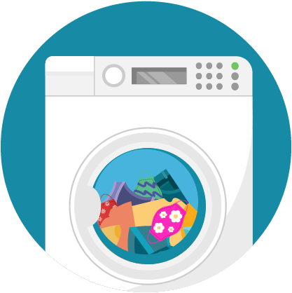
How to Effectively Isolate and Quarantine
Prohibit unnecessary visits to your home.
Bag your garbage and leave outsider your door for pick up.
Wear gloves when doing laundry, cleaning surfaces, etc.
Use separate bathrooms OR if only one bathroom, clean and sanitize between each use.
Have someone else do your laundry if possible. Do not shake dirty laundry.

Slide 14
Protect Yourself & Others: Mask Up!

Slide 15
Protect Yourself & Others: Social Distancing
Stay Home When Not Feeling Well
Socially Distance:
Keep a safe distance of 6 feet or more (2 arms length)

Slide 16
Protect Yourself & Others: Wash Your Hands!
Hand Hygiene
At least 20 seconds (i.e. sing Happy Birthday 2 times) with soap and warm water
Hand sanitizer containing at least 60% alcohol
Do not touch eyes, nose, and mouth with unwashed hands

Slide 17
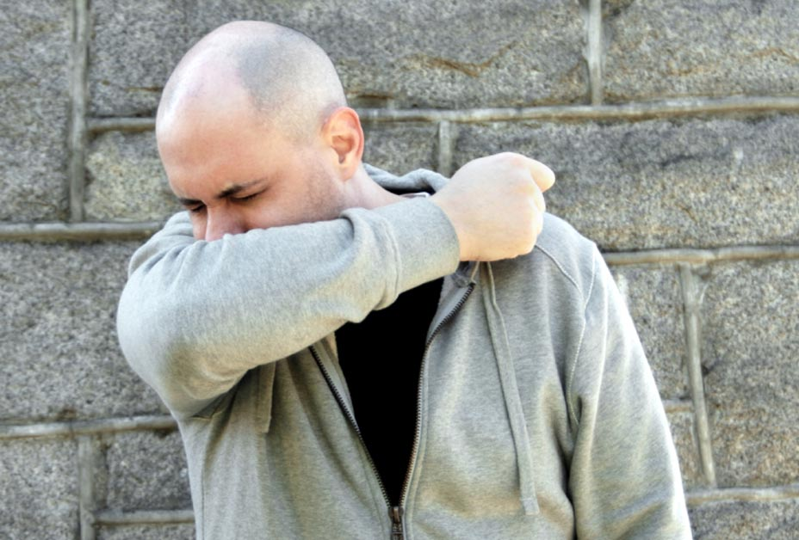
Protect Yourself & Others: Self-Monitor
Cover your coughs and sneezes
Daily Health Checks
Self-monitor for COVID-19 symptoms
Check temperature
Contact medical Care Provider or 911

Slide 18
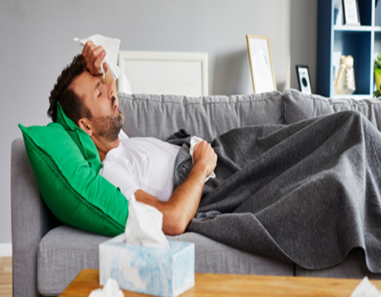
Know Your Risk
Monitor for COVID-19 symptoms daily
Underlying Illnesses:
Obesity
Type-2 Diabetes
Heart Disease
Sickle Cell Anemia
Cancer
Chronic Kidney Disease
Chronic obstructive pulmonary disease
Weakened Immune System from organ transplant
Elderly; pregnant women

Slide 19
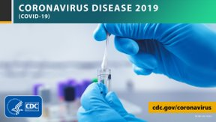
COVID-19 Testing
Diagnostic Testing:
Nose or Throat Swab Test
Current Infection
*Rapid tests are less sensitive and may require a follow up lab-based test
Antibody testing:
Blood Test
Detects exposure NOT current infection
Does not determine immunity
Notes:
Call ahead for appointments
Health insurance
SUNY Albany – Free to NY residents
19

Slide 20
COVID-19 Testing
When to Get Tested:
If you are concerned OR
If you are identified as a close contact OR
If you show COVID-19 symptoms
COVID-19 Testing Sites in Albany County
https://www.albanycounty.com/departments/health/coronavirus- covid- 19/testing-results

Slide 21
COVID-19, Stress and Coping
Stress during the COVID-19 pandemic impacts:
Health status – individual; family; community
Changes in sleep or eating patterns.
Difficulty sleeping or concentrating.
Worsening of chronic health problems.
Worsening of mental health conditions.
Increased use of tobacco, and/or alcohol and other substances.
Source: https://www.cdc.gov/coronavirus/2019-ncov/daily-life-coping/managing-stress-anxiety.html

Slide 22
Coping Resources
Take Care of Your Mental Health
Albany County Department of Mental Health:
https://www.albanycounty.com/departments/mental-health
COVID-19 Support Line: 518-269-6634 (8am-5pm;7 days/week)
Seek Community Support Services and Resources
Regional Food Bank of Northeastern New York
https://regionalfoodbank.net/
Community Resources for Youth:
Albany County Department of Recreation
https://www.albanycounty.com/departments/recreation

Slide 23
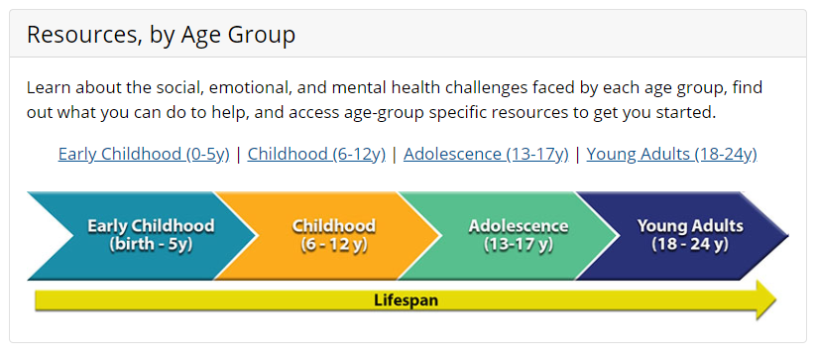
Coping Resources – Teachers, Parents, Children
CDC COVID-19 Parental Resources Kit
https://www.cdc.gov/coronavirus/2019-ncov/daily-life-coping/parental-resource-kit/index.html

Slide 24
STAY SAFE!
STAY HEALTHY!
DO YOUR PART!

Slide 25
REFERENCES
Albanycounty.com. (2020). COVID-19 & Testing Results. Retrieved from: https://www.albanycounty.com/departments/health/coronavirus-covid-19/testing-results
Centers for Disease Control and Prevention. (2020). About Chronic Diseases. Retrieved from: https://www.cdc.gov/chronicdisease/about/index.htm
Centers for Disease Control and Prevention. (2019). About Flu. Retrieved from: https://www.cdc.gov/flu/about/index.html
Centers for Disease Control and Prevention. (2020). Coronavirus Disease 2019 (COVID-19). Retrieved from: https://www.cdc.gov/media/dpk/diseases-and-conditions/coronavirus/coronavirus-2020.html
Centers for Disease Control and Prevention. (2020). Coronavirus Disease 2019 (COVID-19): Your Health – Coping with Stress. Retrieved from: https://www.cdc.gov/coronavirus/2019-ncov/daily-life-coping/managing-stress-anxiety.html
Centers for Disease Control and Prevention. (2020). Flu & People 65 Years and Older. Retrieved from: https://www.cdc.gov/flu/highrisk/65over.htm
Centers for Disease Control and Prevention. (2020). Healthcare Workers: Duration of Isolation & Precautions for Adults. Retrieved from: https://www.cdc.gov/coronavirus/2019-ncov/hcp/duration-isolation.html#:~:text=Available%20data%20indicate%20that%20persons,20%20days%20after%20symptom%20onset
Centers for Disease Control and Prevention. (2020). Physical Activity: Why It Matters. Retrieved from: https://www.cdc.gov/physicalactivity/about-physical-activity/why-it-matters.html
Centers for Disease Control and Prevention. (2020). People at High Risk For Flu Complications. Retrieved from: https://www.cdc.gov/flu/highrisk/index.htm
Centers for Disease Control and Prevention. (2020). Preventive Steps. Retrieved from: https://www.cdc.gov/flu/prevent/prevention.htm
Centers for Disease Control and Prevention. (2020). Symptoms of Coronavirus). Retrieved: https://www.cdc.gov/coronavirus/2019-ncov/symptoms-testing/symptoms.html
Centers for Disease Control and Prevention. (2018). Well-being Concepts. Retrieved from: https://www.cdc.gov/hrqol/wellbeing.htm
Centers for Disease Control and Prevention. (2018). Your Hands Carry Germs You Can’t See: Wash Your Hands. Retrieved from: https://stacks.cdc.gov/view/cdc/59688

